Slide 1
NEA Task 2 information

Slide 2
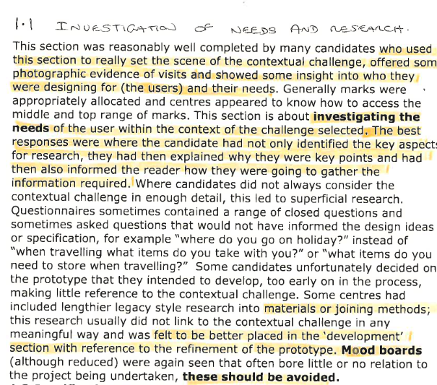
Excerpt from the examiner feedback
The key things to include in the first page;
The question – tell the examiner (again) which question you are doing...give a little context to it...I am exploring this question because...and I am going to base it on the (location / venue). Give a little background information on the location / venue and why this is a good choice....or perhaps you wish to explore more than one before making your choice?
Photographs showing the location / venue – show the examiner where this product is going to be placed / used / interacted with...D.T. Teachers are very visual people...they prefer bullet points, sketches and photographs to paragraphs....the easier it is to mark for the examiner, the more likely he is going to give you the marks.
Give some indication of the user on the first page...then say you are going to do more in-depth research on the user....this will set you up to do a client research page, which could include some ergonomics, an interview etc...perhaps this will be your first page of research?
Make a list of what you are going to research. Tell the examiner along with each point, why these are the key points to research (why are they important?) and how do you plan to gather this information. The exam board would prefer that you went out with a camera, a tape measure, paper and pen (for interviews) and did the research firsthand (yourself) rather than rely on the internet...if you plan to email people...say that you will do this, don't forget you can interview over video link.
Also, don't forget that you will need to research existing products...perhaps list the types of existing products you will look at.

Slide 3
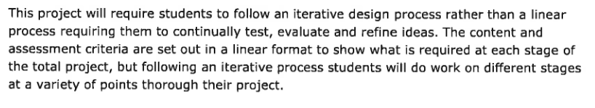

Excerpt from the 'important points to include in the portfolio' document
This is a quote from the document provided by the exam board about 'what students need to do'.
I have put it here to remind you that the NEA is a linear journey (you start at the beginning and keep going until you reach the end).
...you need to tell your story (like a dear diary exercise) about why you did certain things (or planned to do certain things) as you travel through the journey of your portfolio.
Everyone will be taking a different journey through the portfolio, exploring different things for different reasons, testing things in different ways because they thought that was best for them.
From now on I can only give generic ideas of what your portfolio will look like, because everyone's will be different. I will, however, give you individual support / feedback to help you wherever I can.
Remember this video?

Slide 4
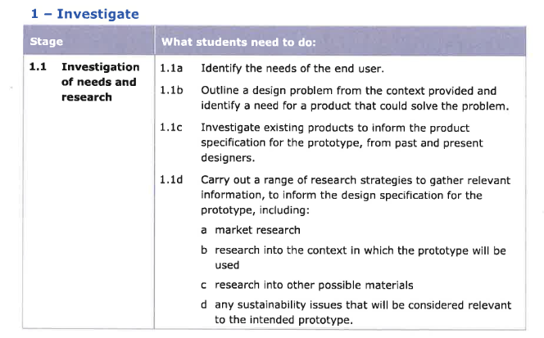
Excerpt from the 'important points to include in the portfolio' document
This is the list of 'what students need to do for the investigation of needs and research.
If you look at Matilde's portfolio, all the way through she quotes numbers...these relate directly to this document. She is showing the examiner that she has addressed each point and where she has done it. The first one you will see on the first slide of examples. It is partly why she did so well, Matilde made sure she covered all the points the examiner will be looking for (remember the mark scheme is a form of tick box criteria).
Most of these points will be covered in your initial research. This all comes before your specification to help you write your specification.
I would suggest at this point, create a specification table. You can then start to fill it in as you find out things in your research.

Slide 5
Excerpt from the 'important points to include in the portfolio' document
1.1 a Identify the needs of the end user.
This is about identifying what the user needs are...not stating what product they need.
For example; my user is not very strong so needs something lightweight.
Or, They could do with somewhere to put an iphone whilst carrying a tray of hungry mice, because my user does not have pockets and is in danger of dropping the phone and if he puts it on the tray a mouse might eat it. The product might then be carried in a backpack when it is not in use and taken home.
On the first page you can just state that you are going to find out the user needs and how. You could give a brief description of the user on the first page and then something more in depth on the client research page. However, if you feel the need you can do some of your client research on this page...it is up to you!

Slide 6
Excerpt from the 'important points to include in the portfolio' document
1.1 b Outline a design problem from the context provided and identify a need for a product that could solve the problem.
This is on the first page....you are telling the examiner about where your product could go...give lots of photo's showing the environment it is going in. What are the needs of this environment for a product? Why is a product needed by people / animals / environment to solve the question?
This can be addressed in more than one area, however, lets stick with page 1 for now...
Don't forget you are describing / researching / talking about the needs for a product. Do not state a product at this stage...if you watch the video on iterative design it should remind you why.
Again, some of your research can appear on page one if you think this is the best place for it.
This point is also addressed in other areas of initial research...where you are researching the environment...the user...it could also come under existing product research.

Slide 7
Excerpt from the 'important points to include in the portfolio' document
1.1 c Investigate existing products to inform the product specification for the prototype, from past and present designers.
This one is self-explanatory...it is your product research page. When you are doing a product research page, please remember to include your user feedback. This will count toward the user needs marks.

Slide 8
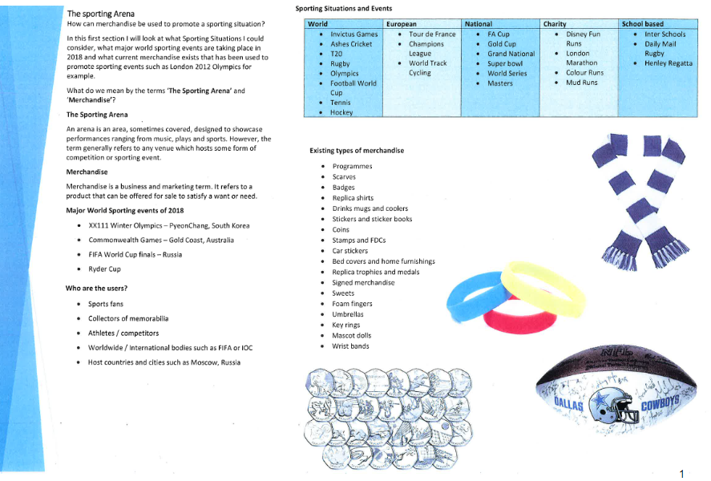
Example 1
From the mixed material NEA portfolio

Slide 9
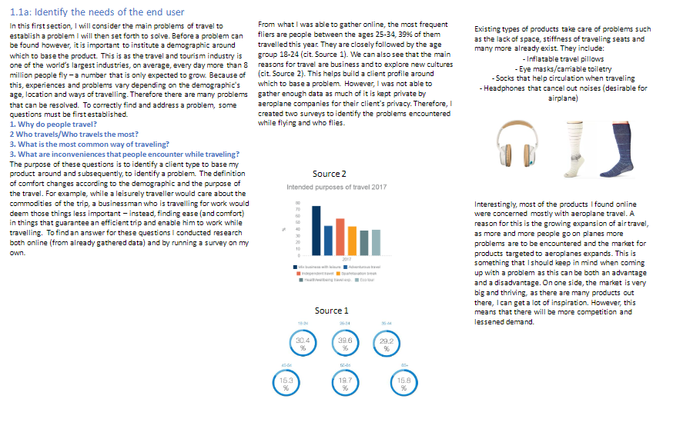
Example 2
From Matilde's portfolio

